Slide 1
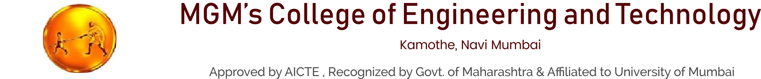
A Mini Project On
Virtual Mouse Using Hand Gesture
Guide : Prof. Rajashri Sonawale
PRESENTATION BY G-22

Slide 2

OUR TEAM
Ashish Nagargoje
Roll no - 83
Vaishnavi Narkar
Roll no - 87
Anurag Patil
Roll no - 102
Nayan Patil
Roll no - 104

Slide 3

TABLE OF CONTENT
1 | Abstract
2 | Introduction
3 | Literature Survey
4 | Objectives
5 | Existing System
6 | Proposed System
7 | Software Requirement
8 | Project Workflow
9 | Applications
10
Conclusion

Slide 4
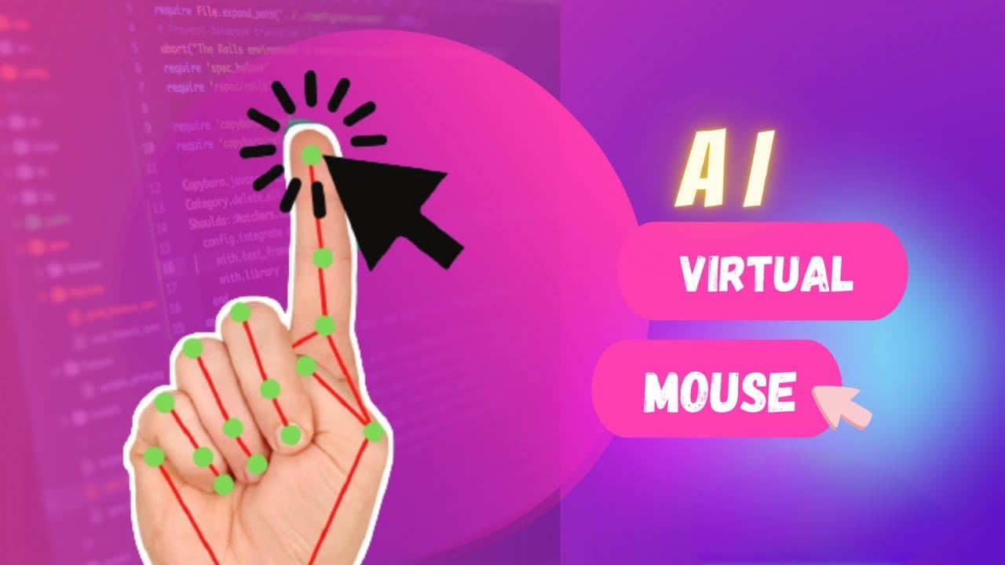
ABSTRACT
● The use of hand gestures as a control mechanism eliminates the need for a physical mouse and provides a more intuitive and natural way of interaction with computers.
● Hand gesture recognition is a natural way of human computer interaction and an area of very active research in computer vision and machine learning.

Slide 5
INTRODUCTION
● A virtual mouse is software that allows users to give mouse inputs to a system without using an actual mouse. To the extreme it can also be called as hardware because it uses an ordinary web camera.
● A virtual mouse can usually be operated with multiple input devices, which may include an actual mouse or a computer keyboard. Virtual mouse which uses web camera works with the help of different image processing techniques.

Slide 6

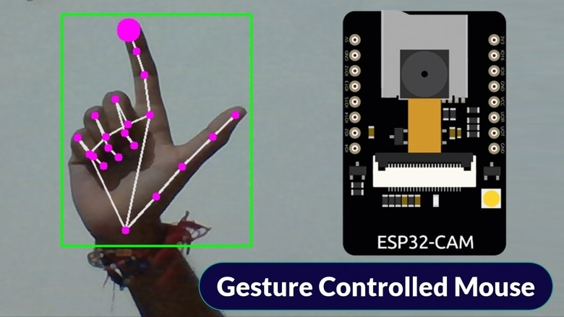
LITERATURE SURVEY
As modern technology of human computer interactions become important in our everyday lives, varieties of mouse with all kind of shapes and sizes were invented, from a casual office mouse to a hard-core gaming mouse.
However, there are some limitations to these hardware as they are not as environmental friendly as it seems.

Slide 7
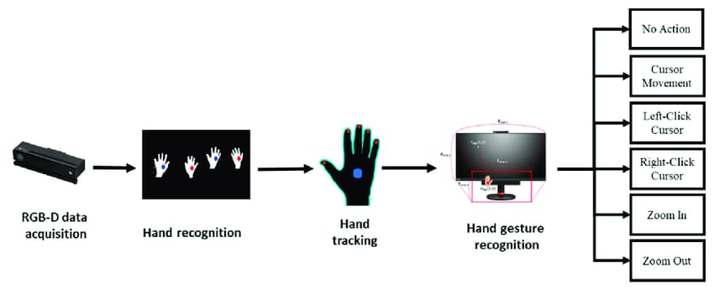
For example, the physical mouse requires a flat surface to operate, not to mention that it requires a certain area to fully utilize the functions offered.Furthermore, some of these hardware are completely useless when it comes to interact with the computers remotely due to the cable lengths limitations, rendering it inaccessible.

Slide 8

Problem Statement
Even today, many of us still find interacting with computers and hardware to be an unpleasant experience, despite the event of input devices over decades. Computers and hardware should be tailored to our natural modes of communication: visual communication and speech. In our purposed project, we've designed a system that has the power to regulate our display screen with the assistance of our hand gestures, which allows a pleasing interaction, and which is free and easy to use. Our purposed Virtual Mouse can be used to overcome problems in the real world such as situations where there is no space to use a physical mouse and also for persons who have problems with their hands and are not able to control a physical mouse. And talked about current world scenario the COVID-19 situation, it is not safe to use the device by touching them because it may result in a possible situation of the spread of the fungus or viruses by touching the devices.

Slide 9
Existing System
The existing system proposed an awfully high demanding cost and resources. Because of this, there have been not many users who could afford it. There are many software or application are present on the internet which claims that they can control the mouse without touching it but on the ground check reality they do not the same as they say instead of they use controlling of mouse virtually by using coloured tape on the finger or using colour monitoring techniques that inappropriate for anyone to manage those kinds of stuff. And at the end, none can get the final accurate outcome or fail to provide the smoothing in the movement of virtual mouse that creates hindrance in using it and disturb the movement of that mouse. Also , the environment utilized in the project wasn't friendly because of which not all userswere ready to handle it. The present system isn'tvery called its many drawbacks to inspect that one

Slide 10
Proposed System
● In the proposed method we are acquiring the important time images and videos from web camera through which is able to be converting the videos into images and can be processing them.
● The converted images will consists of different finger tips that the next step is to extract that tips from the photographs. After the extraction process is finished it'll detect the points using the specified id of corresponding finger tips.
● This process is termed as the detection mode and detecting the points. After the detection of points it'll track the motion of the pointer moving on the screen. After that we are able to perform the action of the mouse.

Slide 11
Software Requirement
Operating System: Windows 11
Coding Language: Python
Tool Kit: Image Acquisition and Image Processing
IDE: VS Code

Slide 12
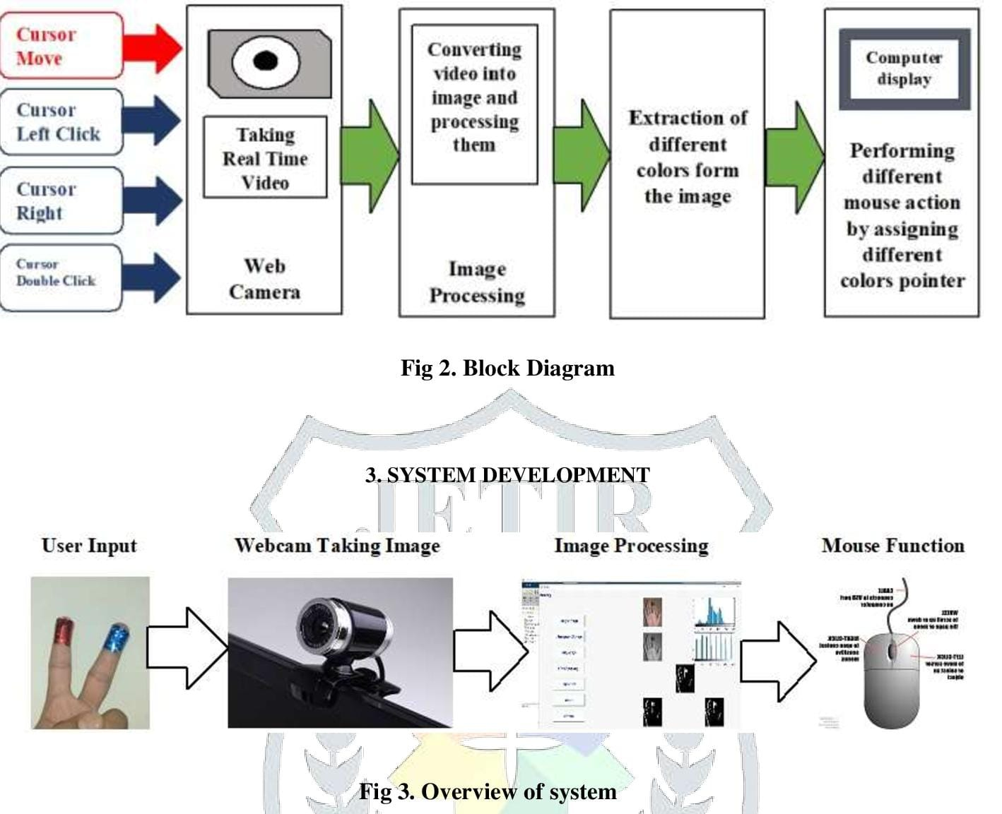
PROJECT WORKFLOW

Slide 13
APPLICATIONS
2D and 3D images may be drawn using the AI virtual system using the hand gestures.
AI virtual mouse are often accustomed play virtual reality- and augmented reality-based games without the wireless or wired mouse devices.
Persons with problems within their hands can use this method to regulate the mouse functions in the computer.
In the sphere of robotics, the proposed system like HCI may be used for controlling robots.
In designing and architecture, the proposed system will be used for designing virtually for prototyping.

Slide 14
REFERENCE
OpenCV Website – www.opencv.org
MSDN Microsoft developers network – www.msdn.microsoft.com
Code project – www.codeproject.com/Articles/498193/Mouse-Control-via-Webcam
Aniket Tatipamula’s Blog - http://Anikettatipamula.blogspot.in/2012/02/hand-gesture-using-opencv.html
Microsoft Research Paperhttp://research.microsoft.com/en-us/um/people/awf/bmvc02/project.pdf

Slide 15
CONCLUSION
Due to accuracy and efficiency plays an important role in making the program as useful as an actual physical mouse, a few techniques had to be implemented. After implanting such type of application there is big replacement of physical mouse i.e., there is no need of any physical mouse. Each & every movement of physical mouse is done with this motion tracking mouse (virtual mouse).

Slide 16
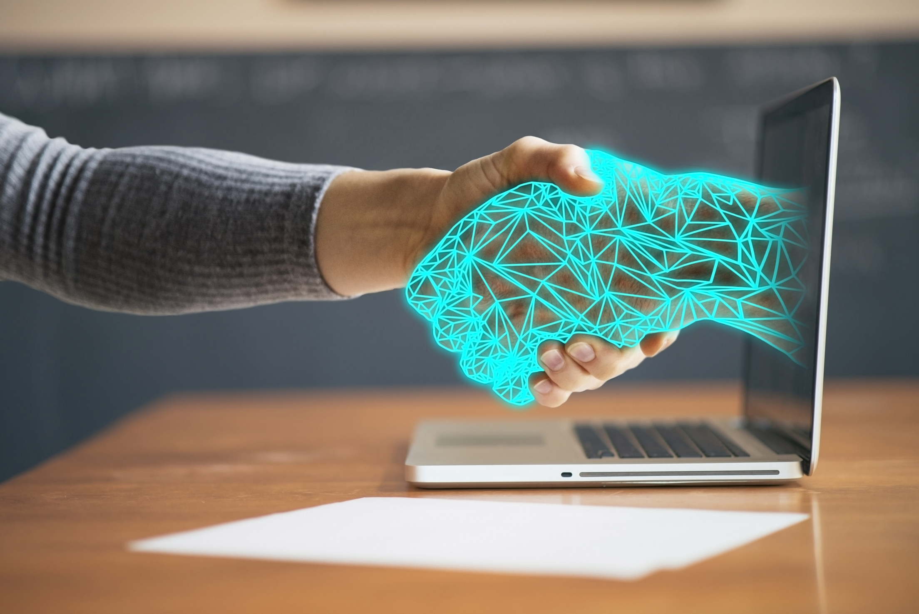
THANK
YOU

